Slide 1
Hardware Development
Tingliang Zhang
The Future Laboratory, Tsinghua University

Slide 2
Outline
What is Hardware Development
A thorough introduction of Microcontrollers
How to develop any prototype
A list of what we need to learn
Discussion about of hardware engineering

Slide 3
Hardware Development

Slide 4

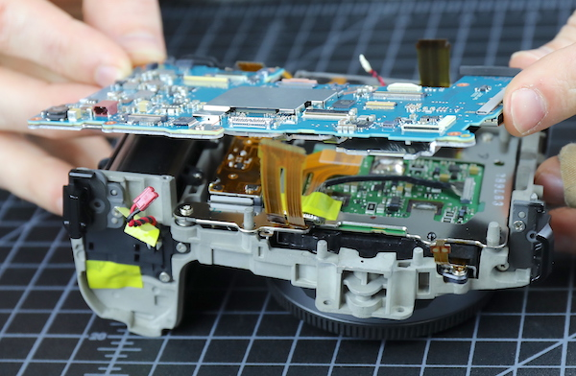

Slide 5
Microcontroller
The center of Hardware Development

Slide 6
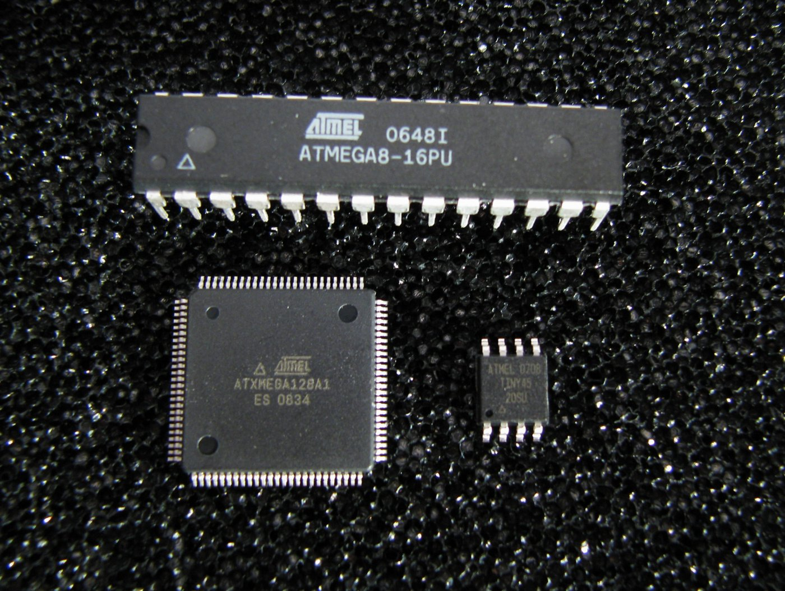
What is a microcontroller?
Microcontrollers are single chip computers that include a minimum of a microprocessor, memory, and input-output module.

Slide 7
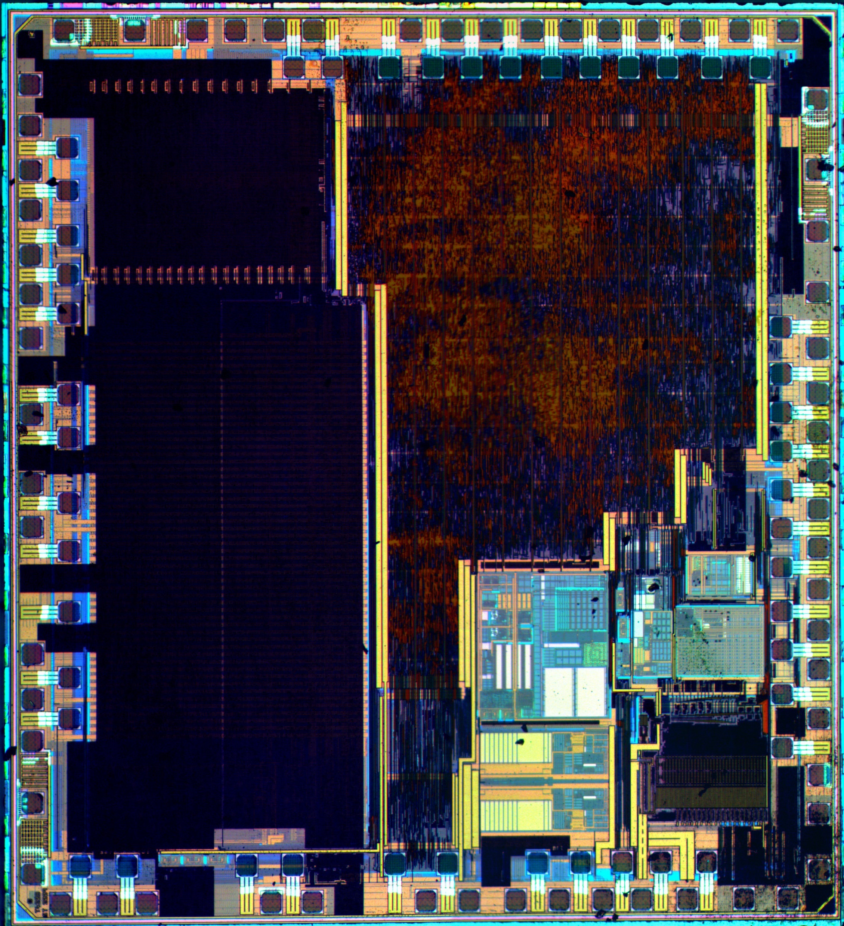
The differences between a microprocessor and a microcontroller.
a microprocessor requires several additional external support chips such as memory and input-output circuits

Slide 8
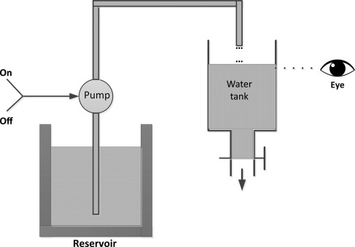
The example of liquid level control system. Fig.1

Slide 9
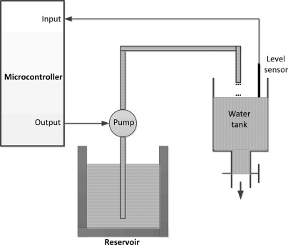
Fig.2

Slide 10
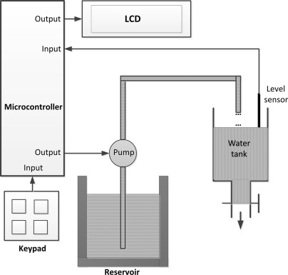
Fig.3

Slide 11
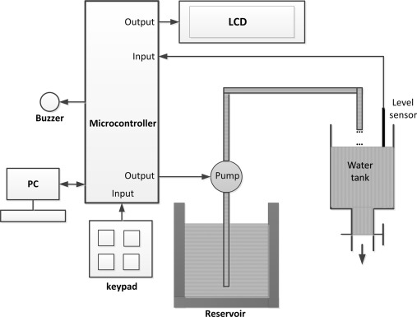
Fig.4

Slide 12
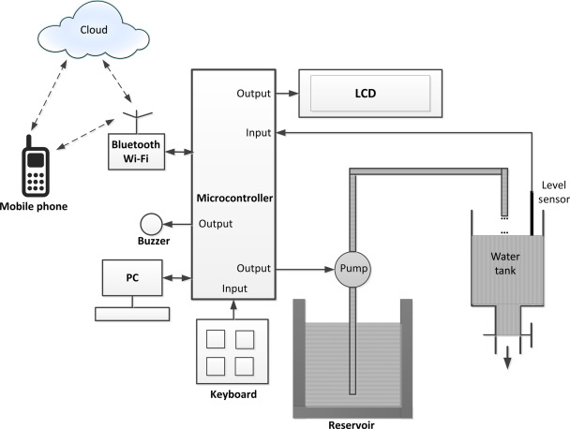
Fig.5

Slide 13
Develop Prototype

Slide 14
How to develop any prototype
- A brief IDEA about any non-pure-software stuff
- Split the function into a few small function
- Decide use which model to achieve each function
- Buy lots of stuff from Taobao, JLC
- Build the prototype
- Test and Debug
- Iterate several times

Slide 15
Skills needed

Slide 16
A list of what we need to learn
1. Dev boards such as Arduino and STM32;
2. Communication protocol such as UART, SPI, I2C, and RS232;
3. Programming languages including C, Python, Java, C++, Verilog;
4. Debug tools such as oscilloscope, waveform generator, multimeter;
5. Peripherals(外设) like brushless motor, servo motor, stepper motor, microphone, IMU, display;
6. Circuits simulate and PCB design tools: Multisim, KiCAD, Altium Designer;
7. Soldering and SMT: QFNP, QFP, BGA, DIP......JLC
8. Algorithms: FFT, PID

Slide 17
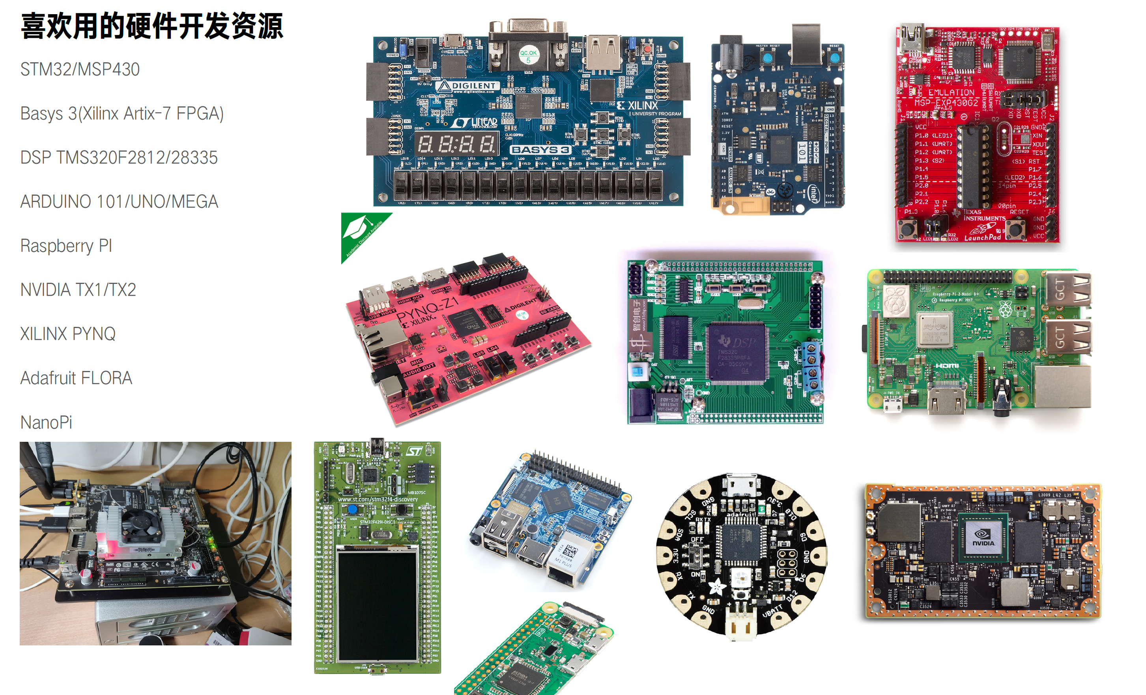

Slide 18
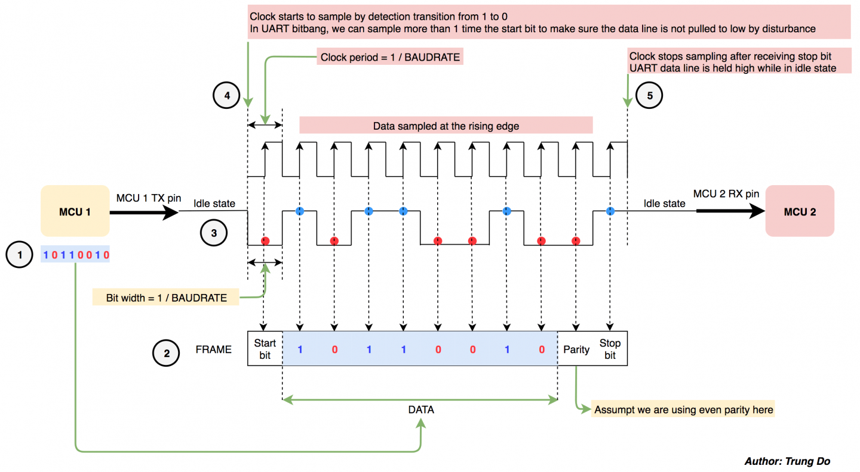

Slide 19
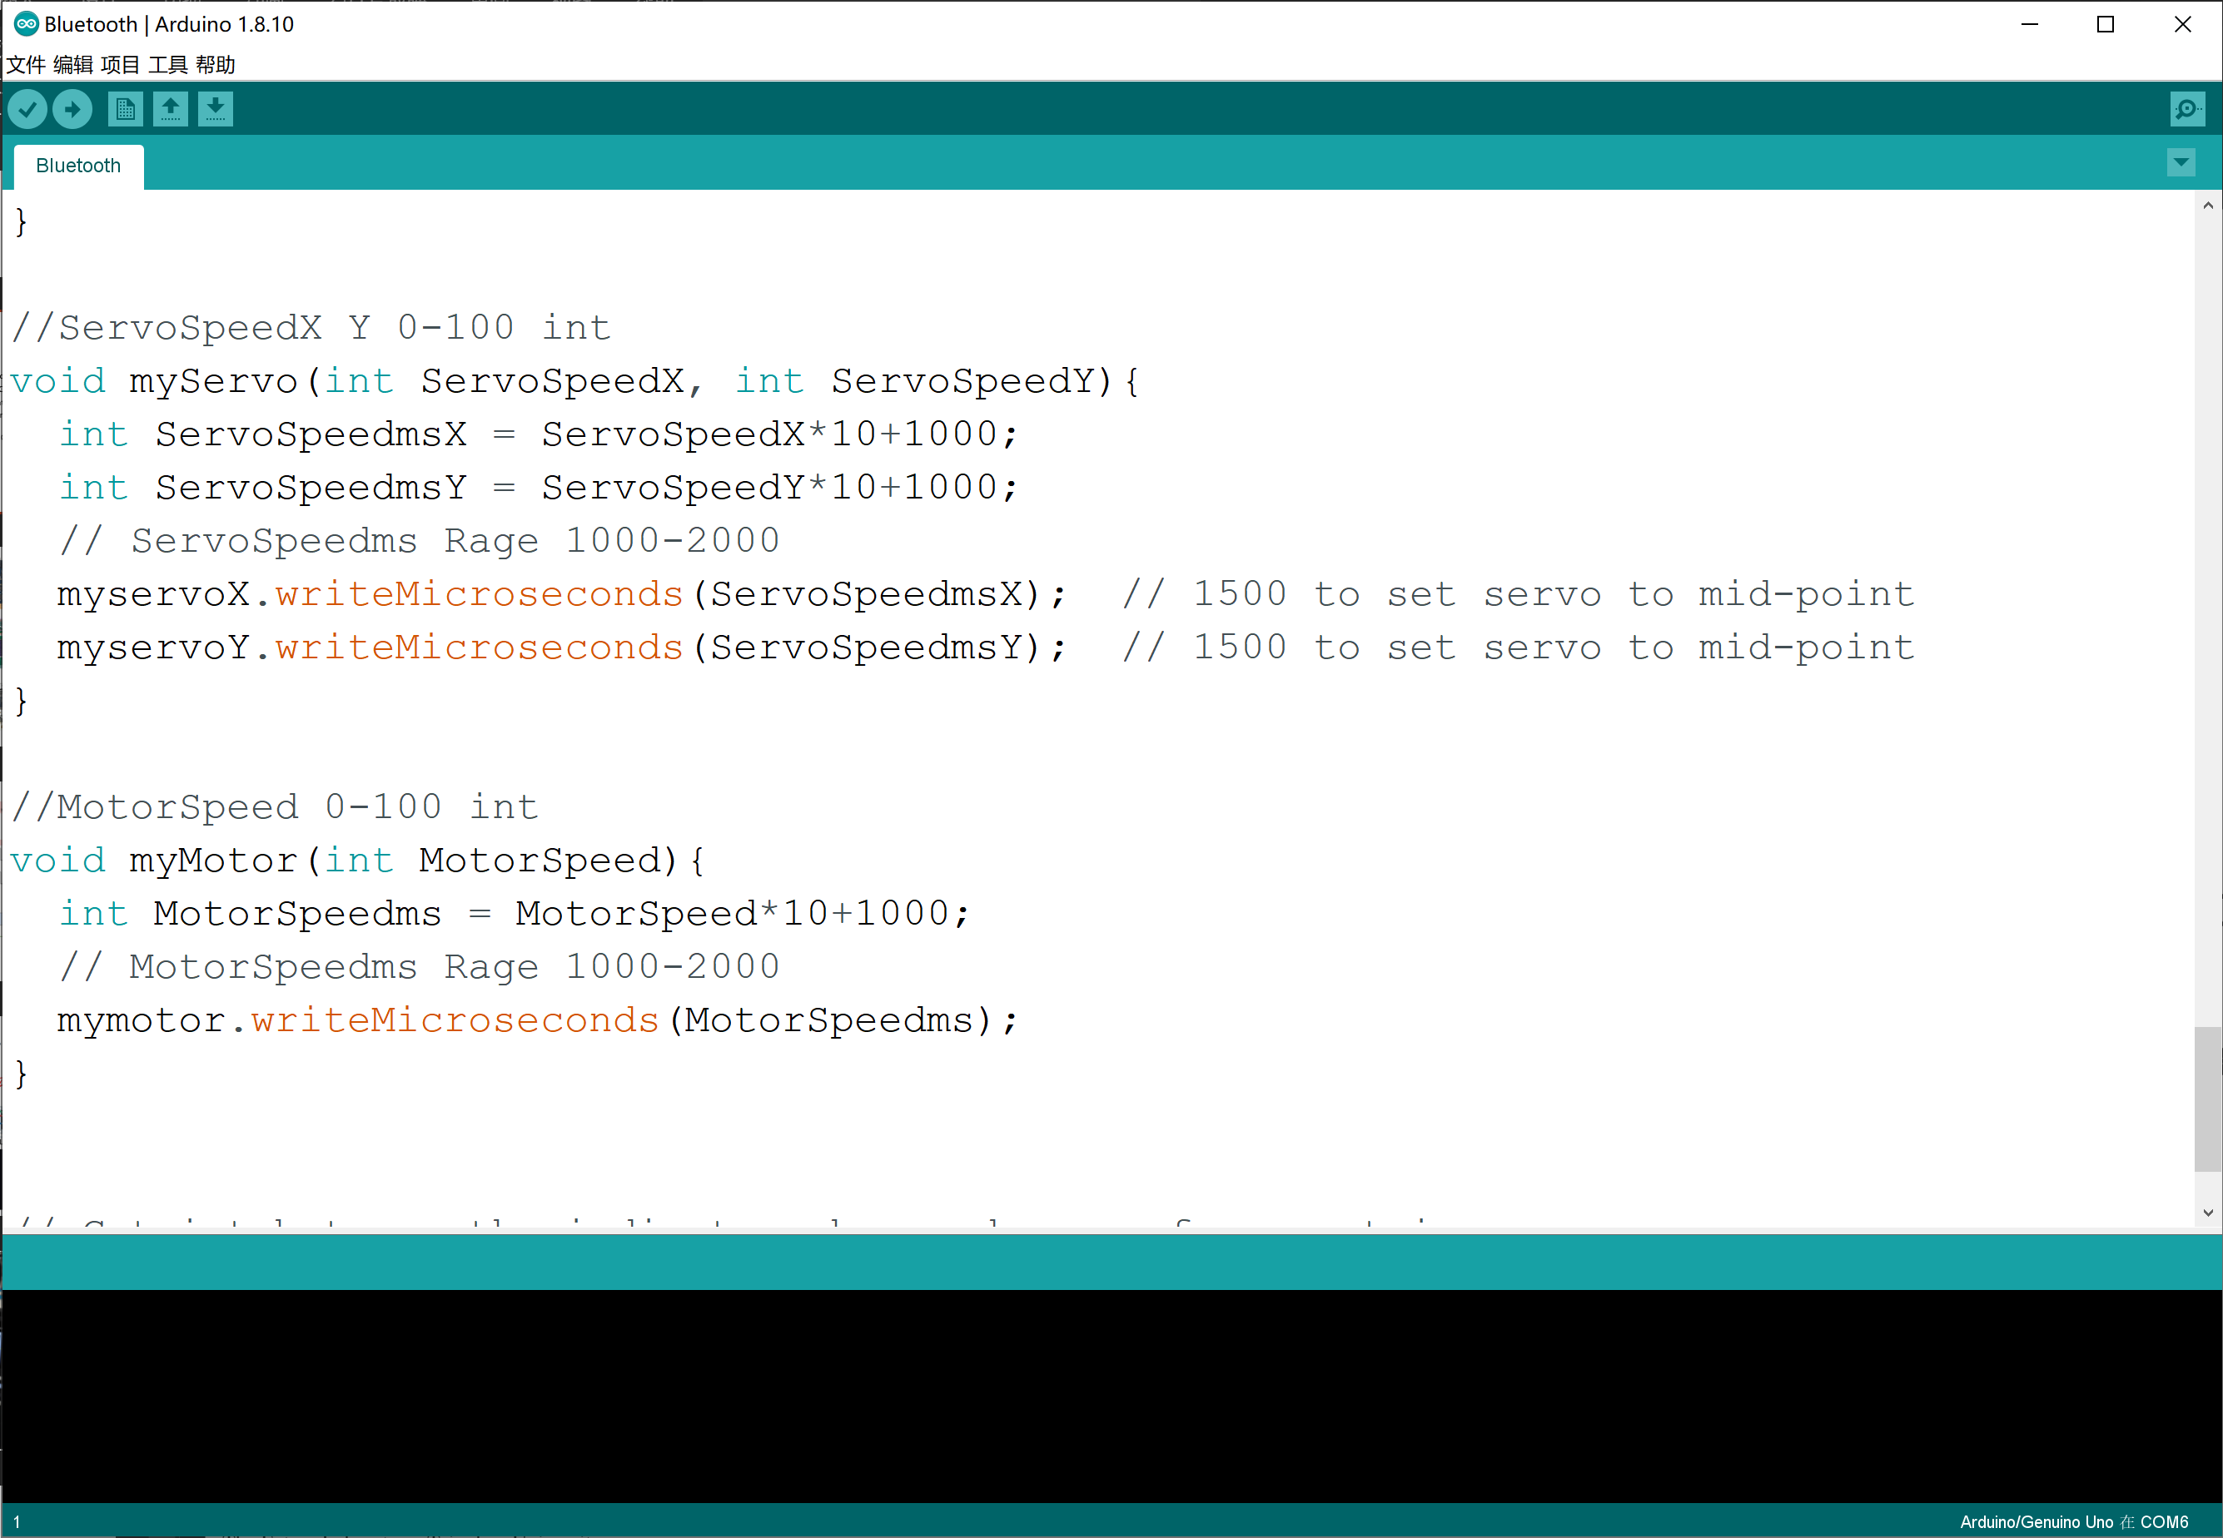

Slide 20
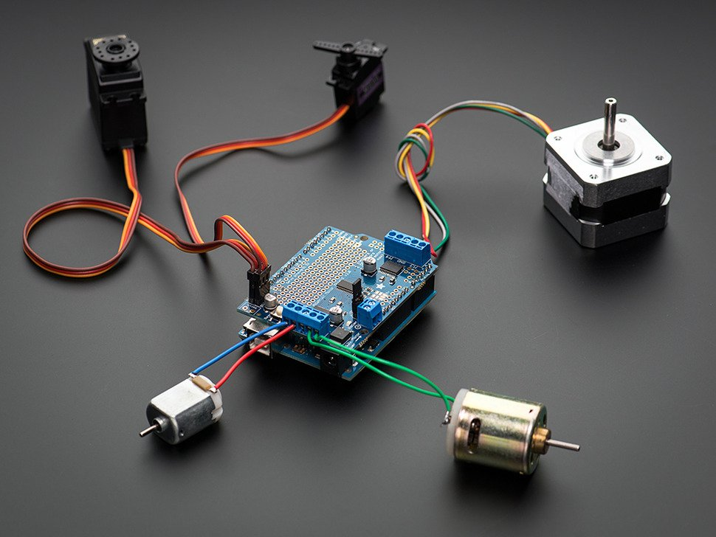

Slide 21


Slide 23
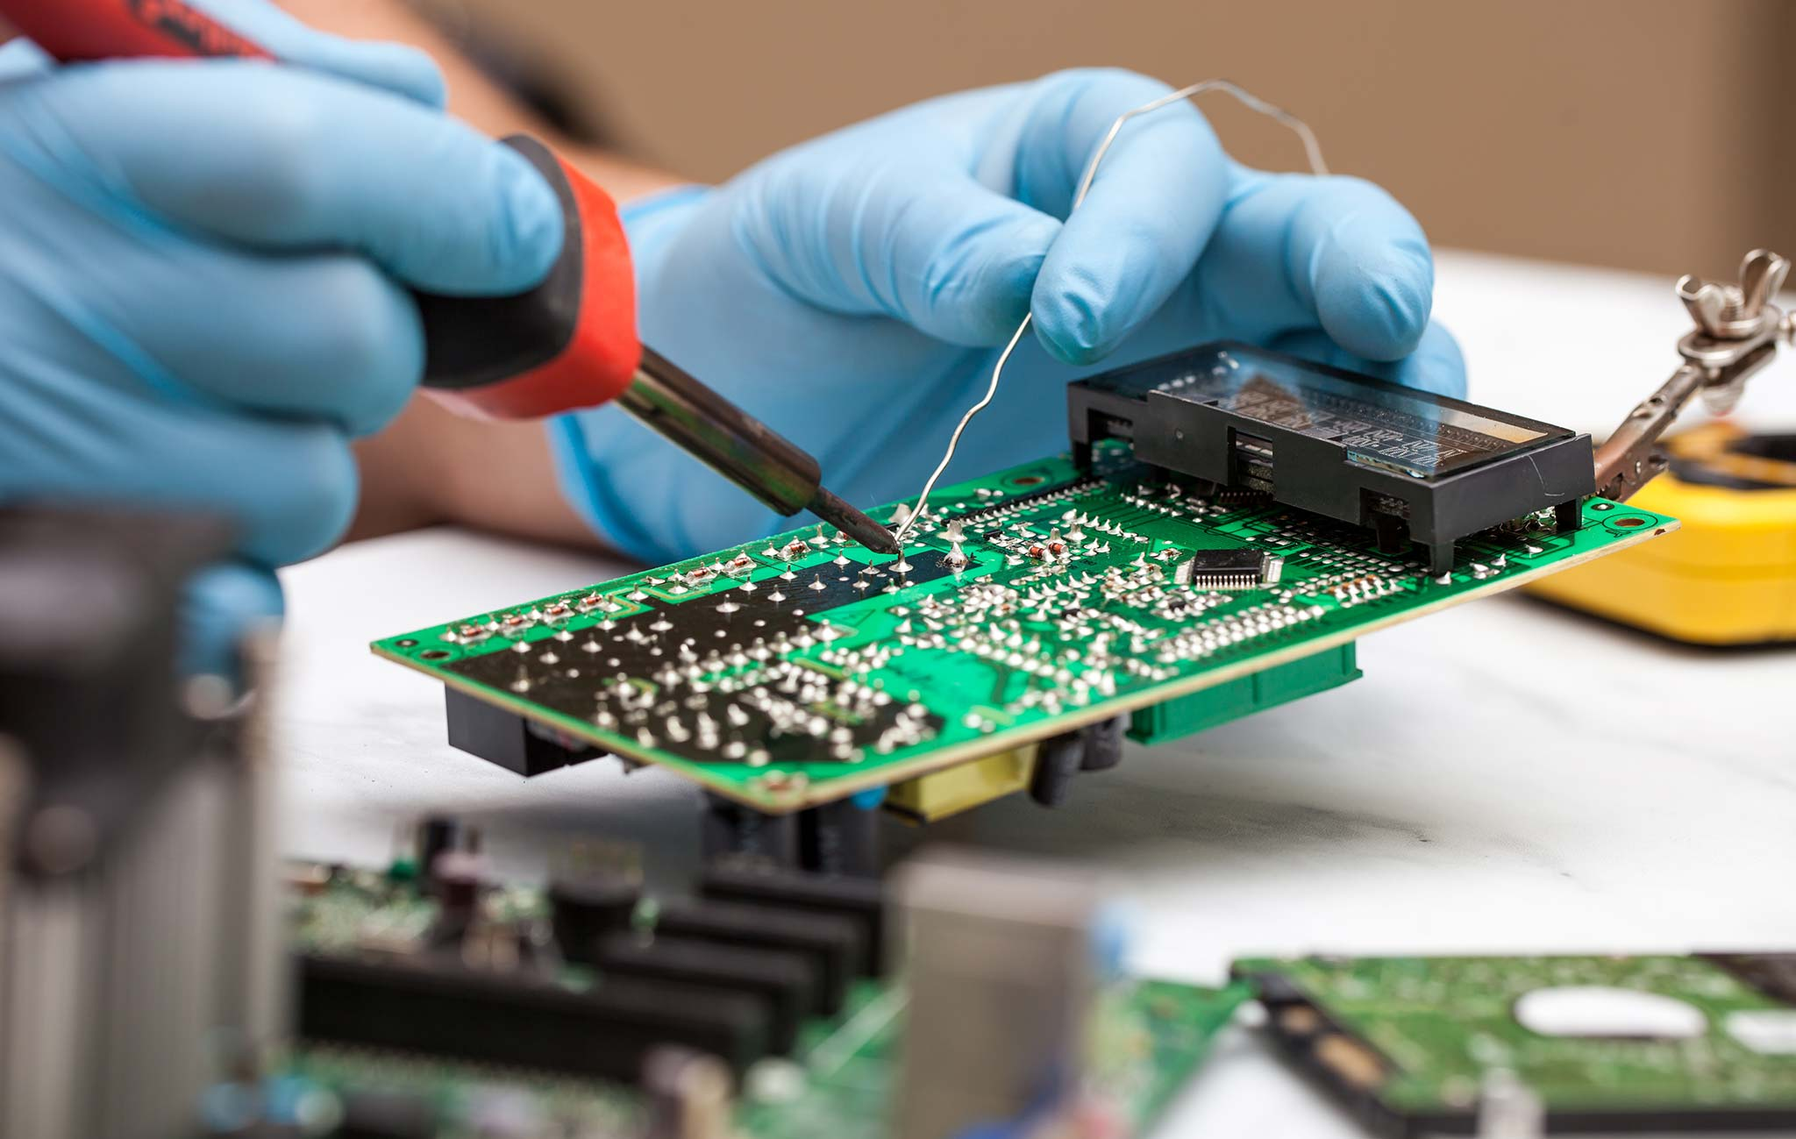

Slide 24
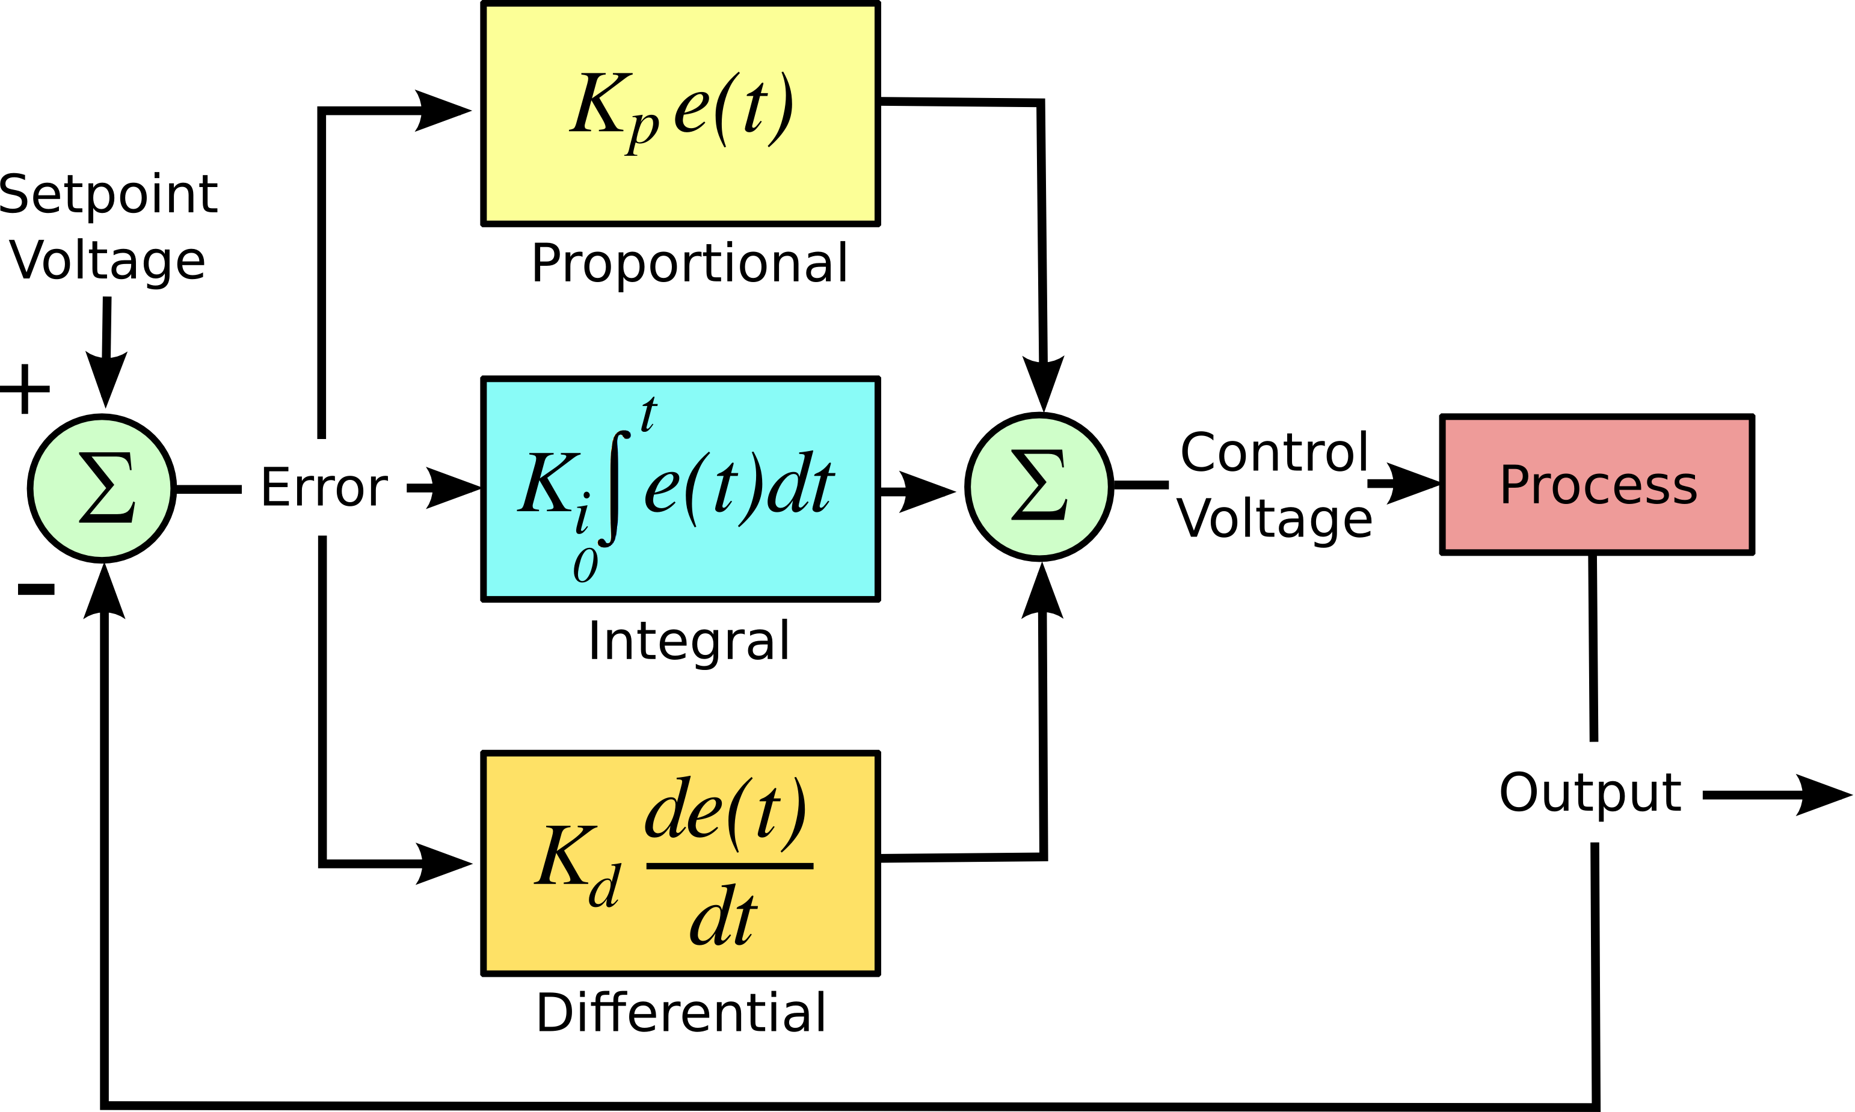

Slide 25
The Future

Slide 26
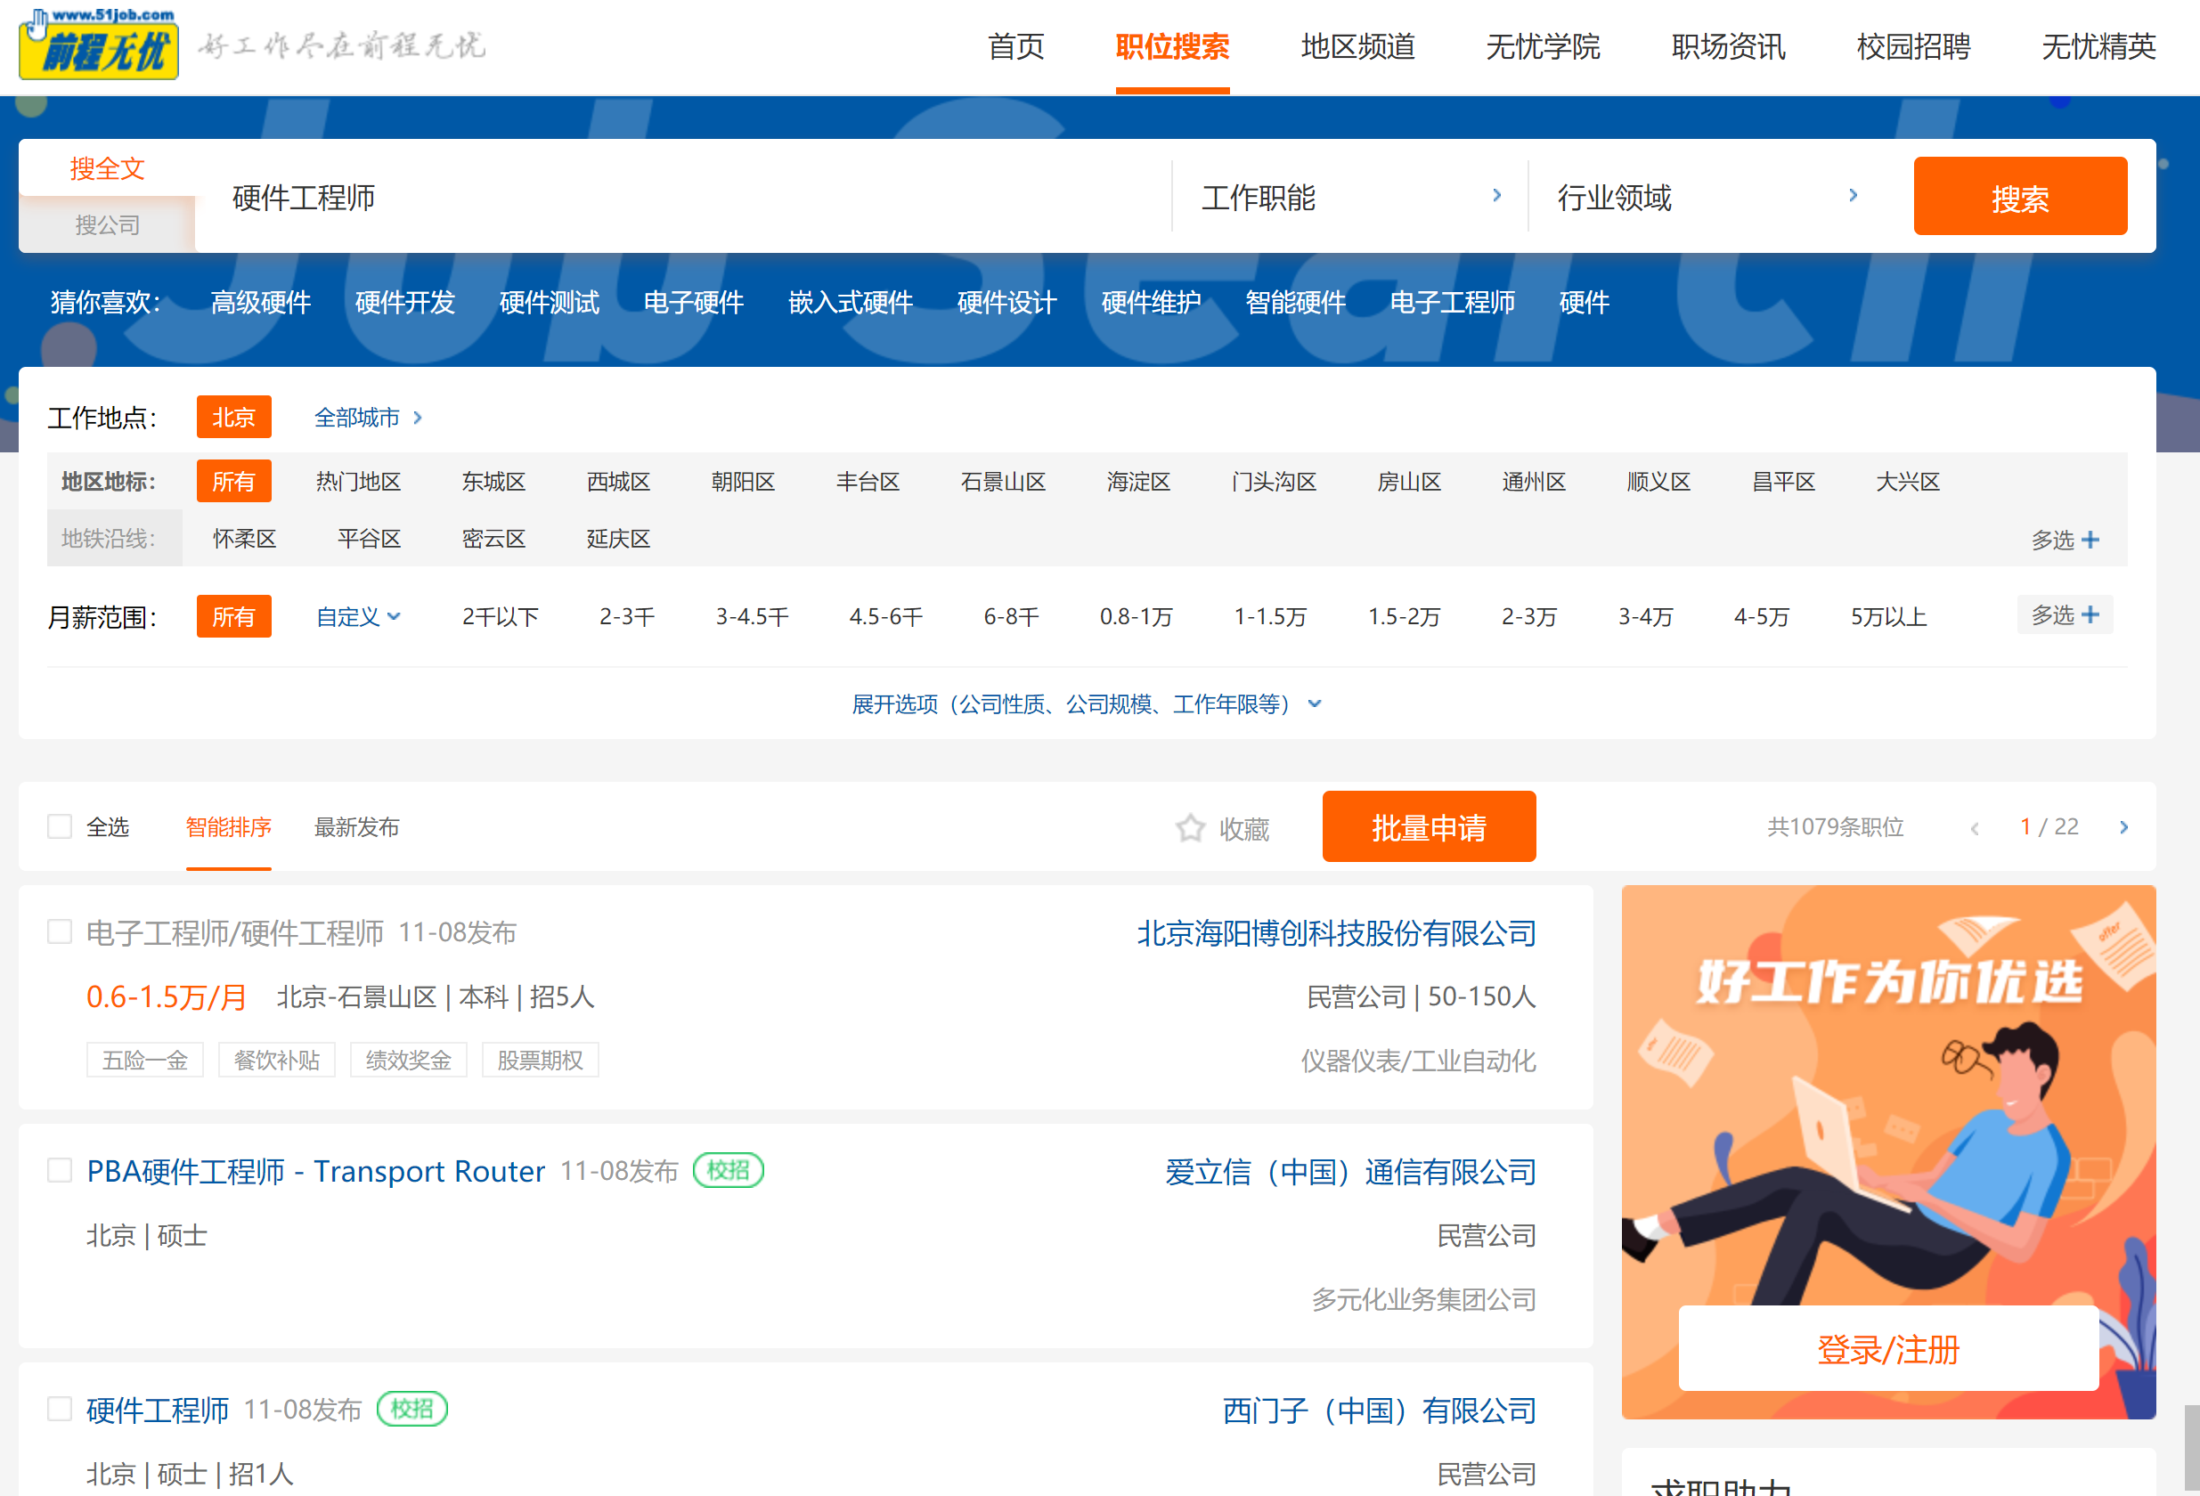
Generally speaking, Hardware Development involves lots of skills, but today hardware engineer in china not yet highly paid. But in the future, when most of jobs can be done by more intelligent EDA tools, the high-end engineers may get high salary as programmers today.

Slide 27
Thanks!

